Slide 1
Cash-Neill Family Newsletter
Inaugural Edition – 1st Quarter 2022

Slide 2
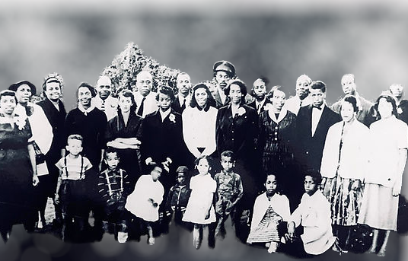
In this edition:
The Cash-Neill Family Portrait October 1956
2022 Cash-Neill Family Reunion
Birthdays & Anniversaries
Cash-Neill Youth Essay Challenge
Births & Accolades
Cash-Neill Family Education Fund

Slide 3
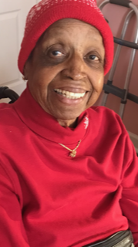
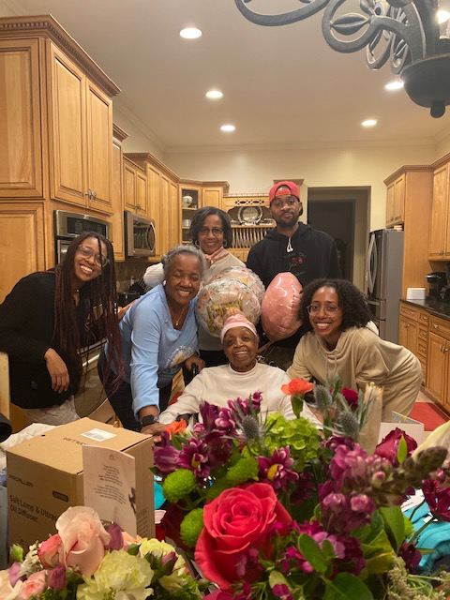
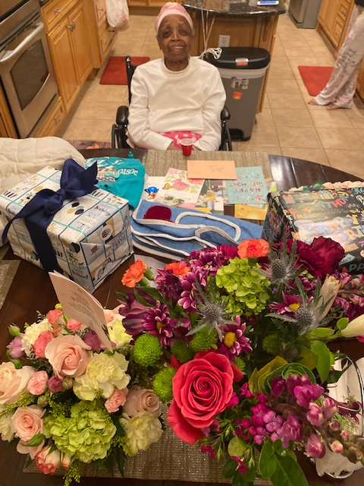
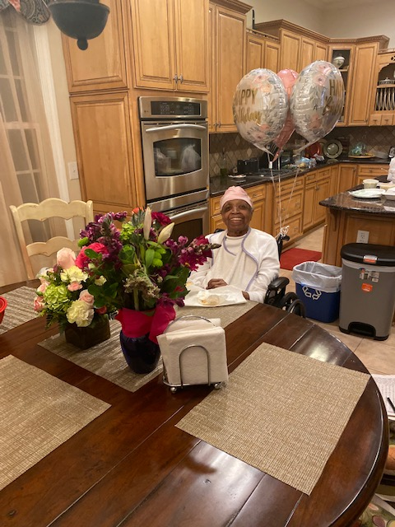
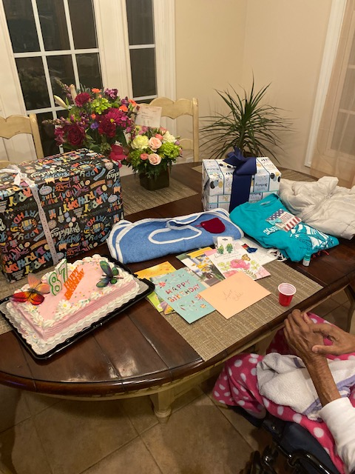
Happy 87th Birthday Aunt Edie
January 25th
Happy 87th Birthday to the family matriarch, Edith Cash Sloan. A big thank you to her brother, sister, cousin, nieces and nephew who sent gifts, cards and flowers.
Note: She sponsored the very first Family Reunion in 1988, in Pisgah Forest, NC.

Slide 4
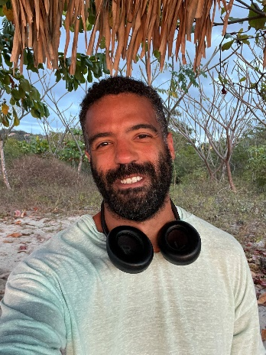
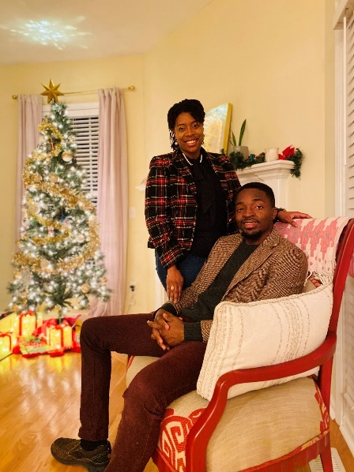
Congratulations to Stephen and Claudette Lewis! They closed on their first family home on December 10, 2021, Stephen’s birthday. They are the proud parents of Cash and Sage.
A hearty congratulations to Wirlen and Tiana Elama on the purchase of their new home in Raleigh, NC. They re-located to Raleigh from California last Summer, to assist with the care of her paternal Grandmother. God has truly blessed them to be able to maintain their West Coast employment while on the East Coast. Tiana is an Environmental Oversight Manager. She was recently promoted to supervisor. Wirlen is a Cancer Research Manager. Tiana is the daughter of Sherrene Jones, the sister of Zarek Jones and the granddaughter of Rose Cash Kittrell.
Bon Voyage to Gerald and Dana Strothers. They are spending two weeks in Hawaii to celebrate Gerald’s birthday!! Dana is the daughter of Frances Bond.
Ean Weslynn
Ean is the son of Brent Wesley Cash, brother of Tessa Marie and grandson of John Wesley and Ethel Mae Cash. Ean is a writer/producer in Los Angeles, CA. He wrote for ‘Black Monday’ on Showtime and ‘Dear White People' on Netflix before leading his first writer’s room last summer.

Slide 5
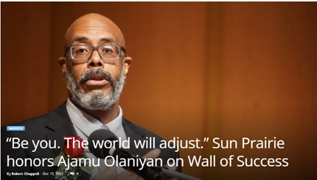
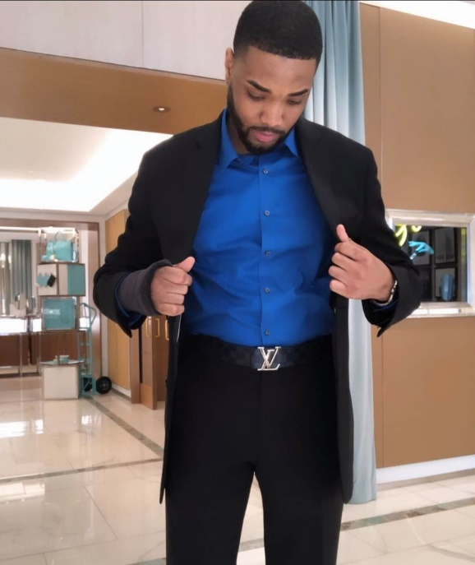
Gwen Cash Jones celebrated Pastor Appreciation Day at St. John Nation in Fletcher, NC.
To view, open this PDF document in Reader, right-click the document, and choose select tool from the pop-up menu. Drag to select text or click to select an image. Right-click the selected link and choose copy, paste in the web address location, and click enter. The 3-minute celebratory video will come up.
Or, you can view on the Cash-Neill family website. Gwen is the daughter of William, Sr. and Barbara Cash.
https://youtu.be/M6rT2qRLnsE
Congratulations to Ajamu Olaniyan f/k/a Dean Cash who was recognized and received the Wall of Success Award for being a distinguished graduate from Sun Prairie High School in Wisconsin. He is currently working on his Ph.D. Ajamu is the proud father of Lanre, Aszurae, Maili, and Harmony. He is the son of John Wesley and Mae Cash
Speech: https://youtu.be/cwD7UUFKpG8
Article: https://madison365.com/be-you-the-world-will-adjust-sun-prairie-honors-ajamu-olaniyan-on-wall-of-success/
Lauryn Lindsey did her initial ministry message at The Rock Church in Anaheim, CA. She did an outstanding job. You may listen to her message on the Cash-Neill website. Her message begins at 1 hr and 10 minutes into the YouTube Video. She is the daughter of Carlton and Helen Lindsey and the granddaughter of Curtis Cash.
Richard Harris made the Top 20 sales list of Tiffany & Co. for the western region for 4th quarter 2021!!!! Congratulations on your hard work and success! Richard is Michelle Rosas and Pam Keith’s nephew.

Slide 6
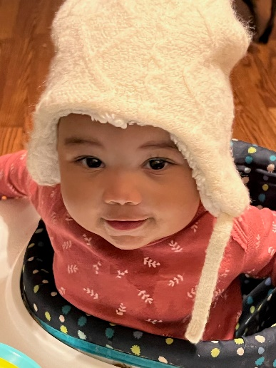
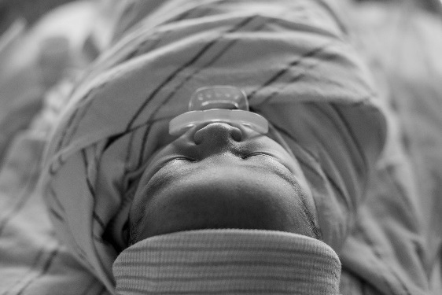
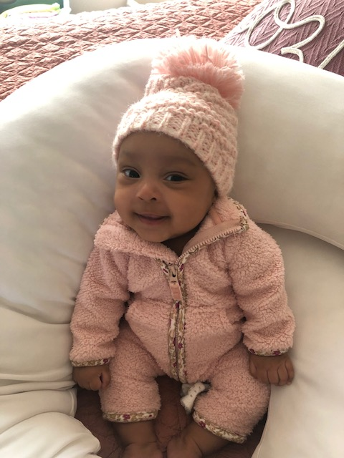
Our Precious 2021 Family Additions
Oliver Wesley Cash 12/21
Son of Eric Cash and grandson of Edward (Ricky), Jr. and Arlene Cash
Allisynne Jane Kittrell
is the precious daughter of Kayla Kittrell – Tony Kittrell’s 1st grandchild and Rose Kittrell’s 1st great-grandchild!
Sage Lewis 12/27-B
The adorable daughter of Stephen and Claudette Lewis. Edward R. Cash,Sr.’s granddaughter.
“Ten Fingers, Ten Toes,
One Perfect Nose”

Slide 7
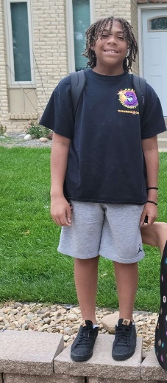
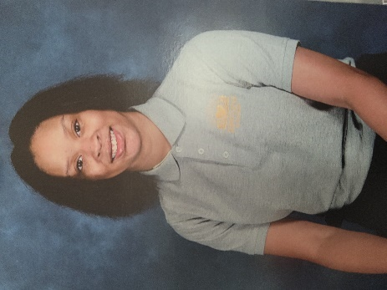
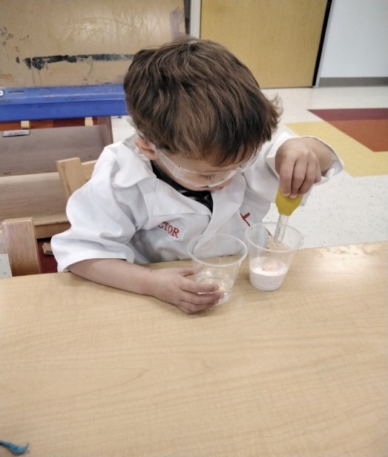
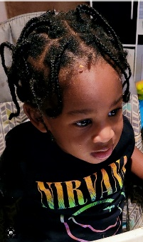
Our Children
Our
Legacy
Congratulations to Yoshi Porter for making the cheerleading squad at her school. She is the daughter of Yolonda Brown and the granddaughter of Reginald Dunbar.
Malaya—She’s such a joy! The daughter of Yolonda Brown and the granddaughter of Reginald Dunbar.
Deric Harris made the Basketball A Team at his High School in Denver, Co. Richard is the nephew of Michele Rosas and Pam Keith.
Cody Lawrence Cash A budding scientist. He’s the son of David L. Cash, II and grandson of David L. Cash, Sr.

Slide 8
Cash-Neill Family Reunion
Mark your calendars now! The Cash-Neill Family Reunion is coming up July 22-24, 2022! We are so excited to get a chance to reunite with family members we haven’t seen in awhile, as well as meet new aunts, uncles, cousins, nieces, and nephews. So that we may include as many people as possible, the Family Reunion will be on-site and virtual. Based on the feedback from the survey family members completed, 37 people said they planned to attend on-site. About 13 are young adults (21-39). For those of you who plan to attend on-site, the following information will help you with your lodging arrangements:
Location: Hendersonville and Pisgah Forest, North Carolina
Lodging: The Cascades Mountain Resort - 201 Sugarloaf Road, Hendersonville, NC 28792 (828) 595-8155, ask for the Cash-Neill Family Room Block
Room Block: 20 Rooms, No Smoking
5 Rooms with 1 King Bed each
15 Rooms with 2 Queen Beds each
Room rate is $129.49 plus tax each night, (King or Queen): Friday, July 22 and Saturday, July 23. If you come in earlier and/or stay later, during weekdays, you will be given the same rate or a lower rate if the price has dropped.
Cut-off date to reserve rooms is May 31, 2022.
Important: Please cancel any “group rate room” by 4 pm (local hotel time} on the day of arrival or earlier to avoid a cancellation penalty!
Each guest is responsible for making room reservations and paying for their own room(s).
Activities: Also, based on your responses to the survey we are planning on having a family dinner, picnic, archival videos/pictures, service of remembrance, board games, card games, outdoor games, virtual games, Talent Showcase, family worship service. We will also be taking individual and group photos of on-site participants. Cashes are competitive so I wasn’t surprised that you wanted to play so many games. We will be sending out more information regarding activities as we finalize the venues.
Should you have questions, email cashneillsteeringcommitteer7@gmail.com. Put “Reunion Question” on Subject line.

Slide 9
Cash-Neill Youth Essay Challenge
About the Challenge
The Cash-Neill Family Reunion Steering Committee welcomes entries in the first Family Youth Essay Challenge which will be held in 2022. The purpose of the Challenge is to invest and encourage our youth to achieve and be the best they can be. The Essay Challenge is open to all Cash Neill family youth 3rd – 12th grade. The essays will be grouped and judged in three separate grade range levels; elementary (3rd – 5th grades), middle school (grades 6th – 8th) and high school (9th -12th grades). There will be one winner awarded for each grade range level. The top prize winner amounts are $75 for high school; $50 for middle schooler and $25 for elementary students.
Essay Challenge Guidelines
Who can enter?
Cash-Neill Youth
Elementary: 3rd-5th grade
Middle school: 6th -8th grade
High school: 9th – 12th grade
Parents are encouraged to assist younger student entrants on the essay guidelines and submittal requirements. Please note however, that each essay must be the sole effort/work of the student entrant.
What is the subject of the essay?
Your essay must answer the following question: What are you thankful for about your family and why?
How long should the essay be?
Elementary student level essays can be handwritten (print) or double space typed and should be about one half (1/2) to one single page in length. Essays submitted by middle school and high schoolers must be double spaced typed and about one and a half (1 ½) to two pages in length.
How should I submit my essay?
Your personal contact information shall be typed at the top of the essay:
First and last name
Grade level and age
Mailing address
Phone number
E-mail address
Essays must be submitted electronically. Scan and attach the essay document to an email with the subject heading Cash-Neill Youth Essay Challenge Entry. Submit your essay entry email with your
attached essay to Cash.Neill.Steering.Committee7@gmail.com.
When is the deadline?
All submissions must be received electronically by 11:59 p.m. Pacific Time, Friday, March 31, 2022.
How will the essays be judged?
The essays will be judged based on 1) organization (how easy it is to read and follow), 2) grammar, 3) spelling, 4) content (is the essay presented in an interesting, creative way) and 5) how well the essay addressed the question/topic.

Slide 10
Dear Family Members,
I am your Mother, Grams, Aunt or Cousin--Rose Cash Kittrell. I’m making a special appeal for you to invest in our family’s Educational Fund. The money will be used to award monetary prizes for the essay contest, and to give financial blessing to high school graduates and post-secondary graduates. We are asking each adult family member to donate at least $100 or more, to help us establish the fund. Thus far, we have received $1,000 just through informal conversations. So, let’s do the math. We have at least 50 adults (21 and over) who could contribute and make a difference in the life of our youth.
25 adults x $100 = $ 2500
10 adults x 150= 1500
15 adults x 200= 3000
Total 7000
Our family has always supported educational pursuits. My sister Margaret, who was the second oldest daughter in the Otis B. Cash, Sr. family, did not have the opportunity to go to college, but she was willing to invest in my sister Edith. She paid her first Semester’s tuition so that she could get into college, and then provided financial assistance for each second semester for the next three years. When Edith finished, she invested in my sister Virginia, me and my daughter. My brother Curtis also helped me financially during my undergraduate studies.
My sisters and brother did not obligate us to repay them. Nevertheless, we would do special things for them just as a way of showing our appreciation. I, of course, have contributed to the educational pursuits of my children and grandchildren and others in the family. To quote my sister Edith, “The more people we can educate in the family, the better the family will be overall. We will become self-sufficient.”
You may think that you don’t have it to give. Try not to think like that. That’s a LACK mentality. A lack mentality is fearful of not having enough, so, the hand is closed. Nothing can go out of a closed hand and guess what? Nothing can go in either. You want to think positive and devise a plan to contribute to this worthwhile family endeavor. Maybe you could eat in and make your coffee at home for a week or month. You know your habits and perhaps ways you can cut back. I am in hopes you will help us achieve our goal and make your investment today. See article below on ways to give.
We will keep you updated on our progress in collecting donations. In the meantime, continue to be a positive role model and encourage our children and youth to achieve excellence in all their endeavors.
A Word from Our Elder

Slide 11
How to Give Funds to the Cash-Neill Family Education Fund
If you would like to invest and give funds to the Cash-Neill Family Education Fund you may do so by electronic transfer into a special family account which is currently being handled by Keretha Cash. If you have a Zelle account with your bank, add Keretha Cash’s phone number (608 212 2294) or email (keretha@gmail.com) to deposit into the Education Fund’s Zelle account. Alternatively, you may send a cashier’s check or money order to the following address:
Keretha M. Cash
1775 Linnerud Dr. #101
Sun Prairie, WI 53590-3610
A regular update on our progress in collecting donations will be provided on the second Sunday family call and in the Cash-Neill family newsletter. Thank you for your investment in our family.

